Slide 1
Identification of Different Medicinal Plants/Raw materials through Image Processing Using Machine Learning Algorithms
PIP4004 University Project
Review-3
Batch Number: CSE_CAI_CAP_07
Under the Supervision of,
Dr. Afroz Pasha
Assistant Professor
School of Computer Science and Engineering
Presidency University
Roll Number | Student Name
20211CAI0078 | B MEENU
20211CAI0201 | V DEEKSHITHA
20211CAI0180 | GADDAM SAI LIKHITHA
20211CAI0115 | AISHWARYA VILAS PATIL

Slide 2
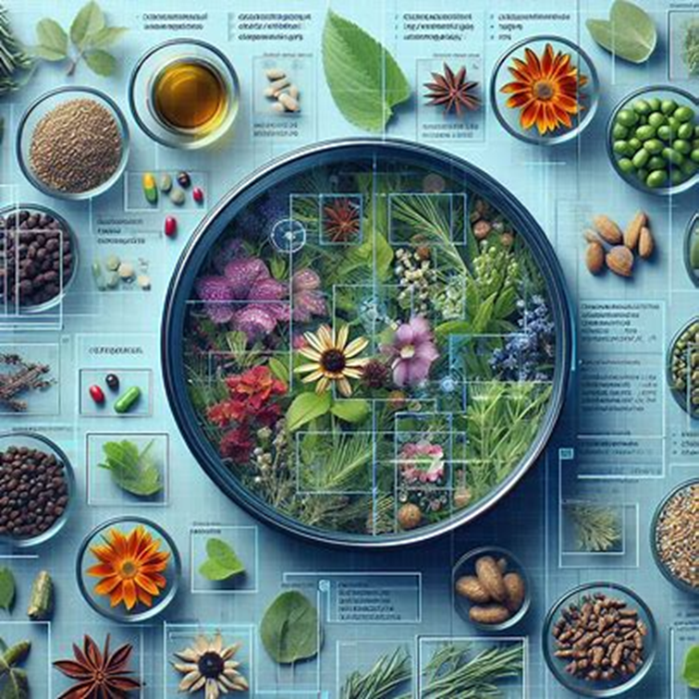
Introduction
Medicinal plants have been used for centuries to treat various ailments. However, identifying the correct plant can be challenging, as many plants look similar. This can lead to misidentification and potentially harmful consequences.
Image processing and deep learning algorithms offer a promising solution to this problem. By analyzing images of plants, these technologies can identify different species with a high degree of accuracy. This can be a valuable tool for researchers, healthcare professionals, and anyone interested in using medicinal plants safely and effectively.

Slide 3
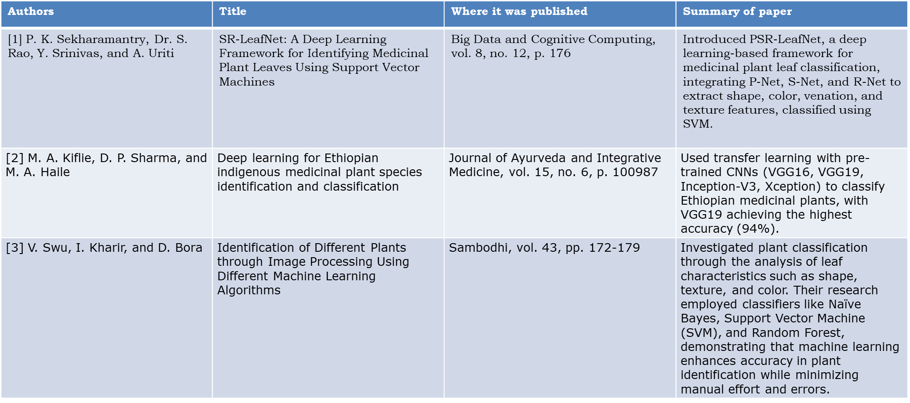
Literature Review

Slide 4
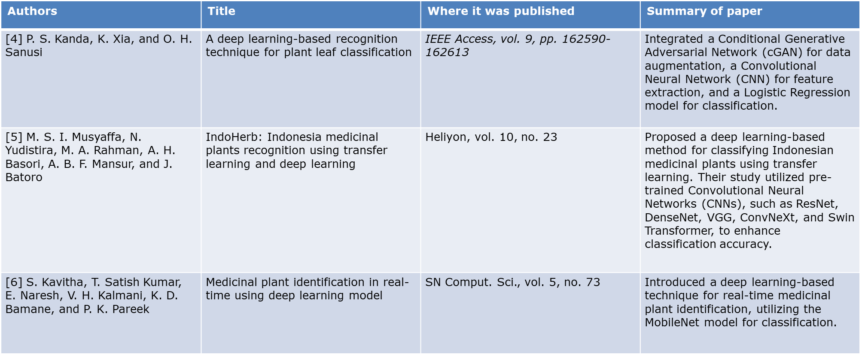
Literature Review

Slide 5
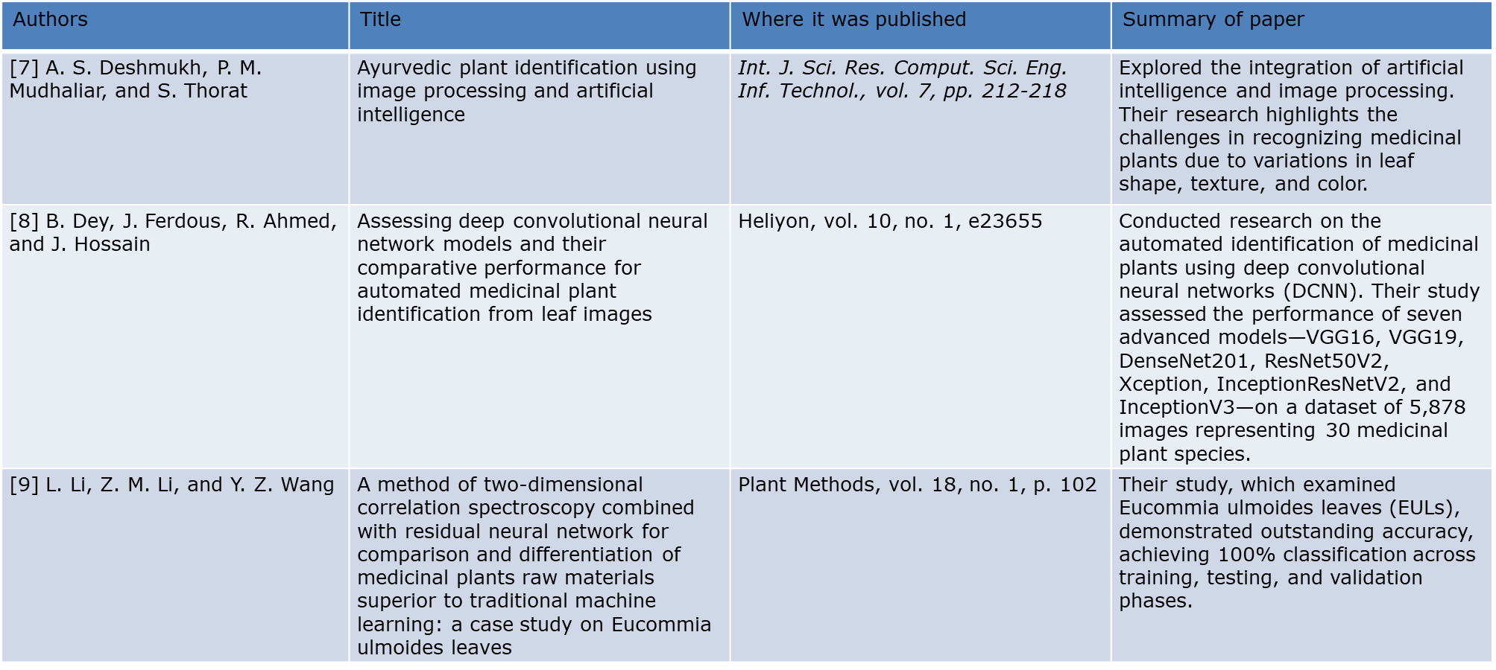
Literature Review

Slide 6
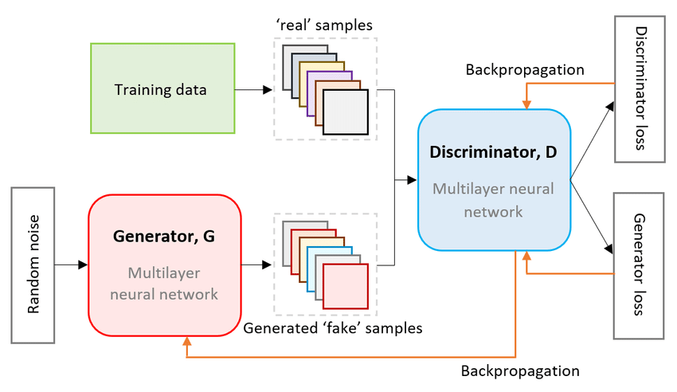
Methodology-Generative Adversarial Networks
GANs are a class of neural networks that autonomously learn patterns in the input data to generate new examples resembling the original dataset.
GAN’s architecture consists of two neural networks:
Generator: creates synthetic data from random noise to produce data so realistic that the discriminator cannot distinguish it from real data.
Discriminator: acts as a critic, evaluating whether the data it receives is real or fake.
They use adversarial training to produce artificial data that is identical to actual data.

Slide 7
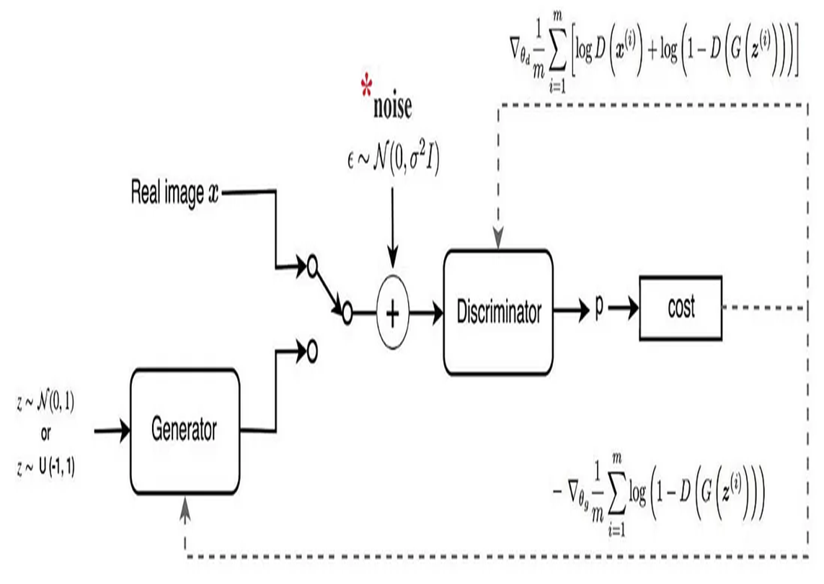
Methodology-Wasserstein Generative Adversarial Networks (WGANs)
WGAN's architecture uses deep neural networks for both generator and discriminator.
The key difference between GANs and WGANs is the loss function and the gradient penalty.
The WGAN architecture consists of a generator and a critic (instead of a discriminator).
The critic evaluates the quality of the generated samples and provides feedback to the generator.
The key innovation is the use of weight clipping or gradient penalty to enforce the Lipschitz constraint, ensuring that the critic's function remains 1-Lipschitz.
This leads to more stable training dynamics and allows for a more meaningful measure of distance between the real and generated data distributions.

Slide 8
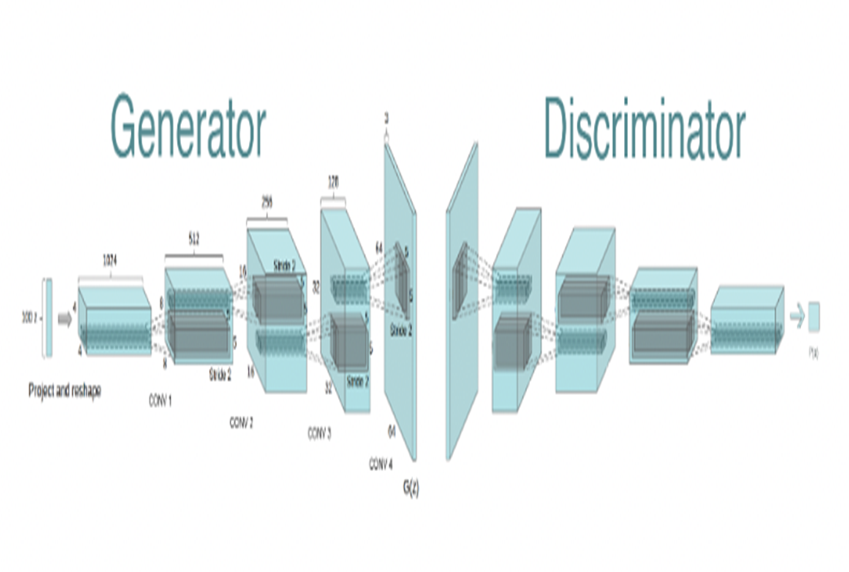
Methodology-Deep Convolutional GAN
DCGAN uses convolutional and convolutional-transpose layers in the generator and discriminator, respectively.
Here the discriminator consists of strided convolution layers, batch normalization layers, and LeakyRelu as activation function.
It takes a 3x64x64 input image. The generator consists of convolutional-transpose layers, batch normalization layers, and ReLU activations.
The output will be a 3x64x64 RGB image.

Slide 9
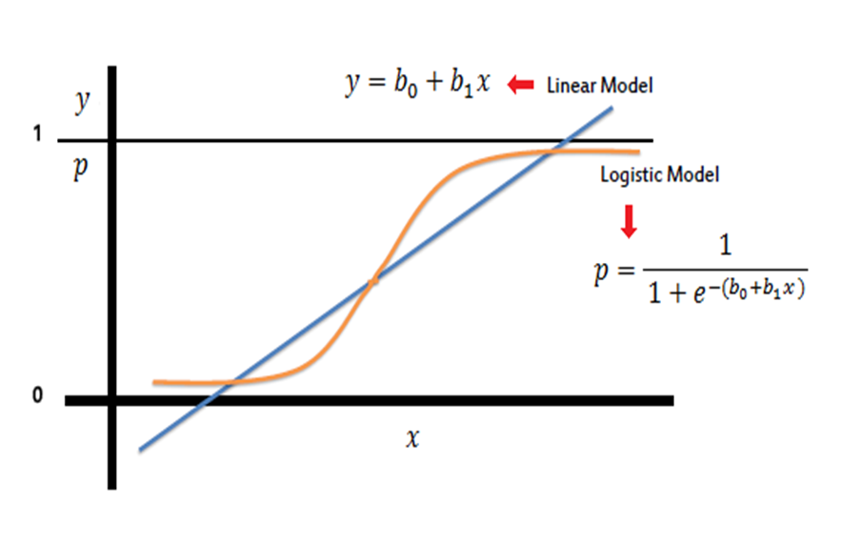
Methodology-Logistic Regression
Logistic regression is a supervised machine learning algorithm used for classification tasks where the goal is to predict the probability that an instance belongs to a given class or not.
Multinomial Logistic Regression is implemented in our code.
statistical method used for binary classification problems, but it can be extended to multi-class classification using techniques like one-vs-rest (OvR) or softmax regression.

Slide 10
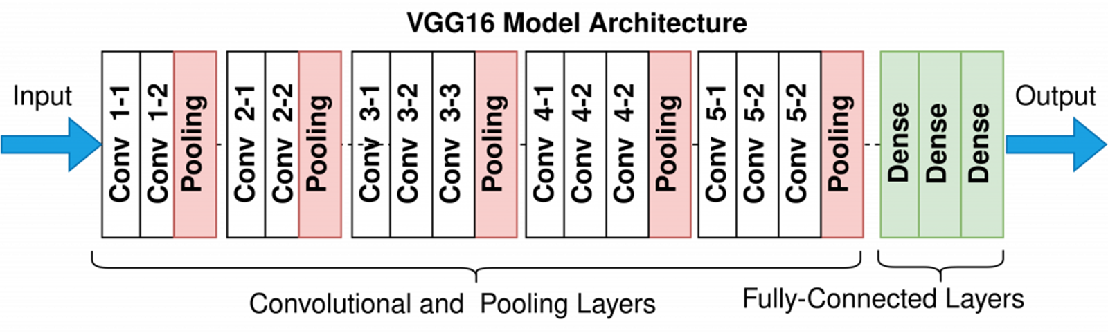
Methodology-VGG16
VGG16 is made up of 16 layers of artificial neurons that process image information
It uses 3x3 convolution filters and 2x2 maxpool layers
The network has two fully connected layers, followed by a softmax for output
VGG16 is trained on a subset of the ImageNet dataset, which contains over 14 million images

Slide 11
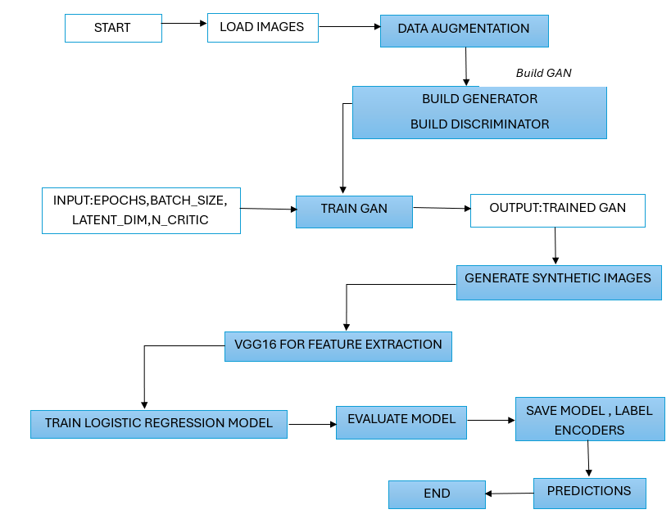
Proposed Method-GAN with Logistic Regression

Slide 12
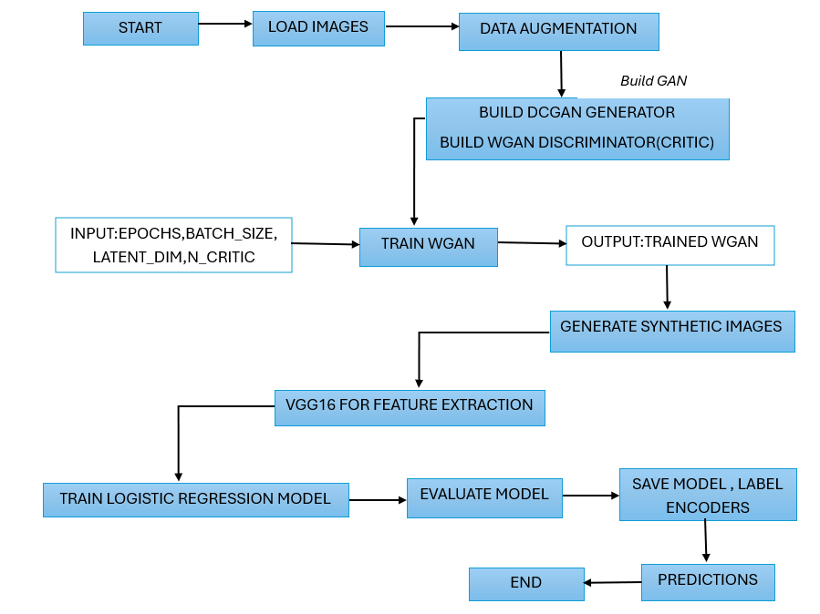
Proposed Method-WGAN,DCGAN with Logistic Regression

Slide 13
Objectives
Develop a hybrid model for Medicinal Plant Identification.
Create a Curated Dataset of Medicinal Plants and Raw Materials.
Extract and Analyze Unique Visual Features for Classification
Build a Prototype Application for Practical Demonstration

Slide 14
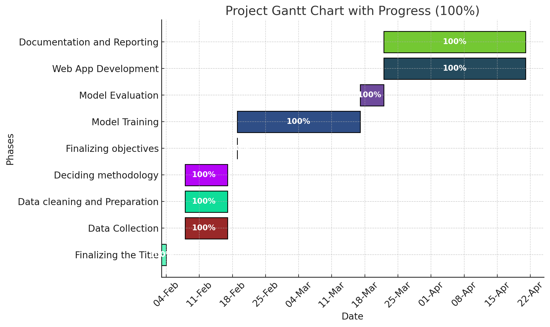
Timeline of Project

Slide 15
Results
We utilized a stratified k-fold cross validation with 5 splits ,repeated 3 times. The model is trained and validated 15 times(5 folds x 3 repeats).Each fold is used as validation set while the remaining is used as training sets. The accuracy scores for each fold were recorded(table 1), providing insights into the model's performance across different subsets of the data. The mean accuracy across all folds was calculated to summarize the model's overall performance. The model 2 outperformed model 1.
Model 2 identifies the plant species accurately.
The two models are :
GAN with Logistic Regression(Model 1)
WGAN and DCGAN with Logistic Regression(Model 2)
Model | Mean Accuracy | F1-Score
Model 1 | 0.9021 | 0.8923
Model 2 | 0.9885 | 0.9883

Slide 16
Conclusion
This project adequately illustrates the detection of various medicinal plants and raw materials by image processing with the aid of machine learning algorithms. Integrating data augmentation and synthetic image generation enhanced significantly the training data diversity and robustness, leading to its high performance for multi-class image classification tasks. With the employment of Generative Adversarial Networks (GAN, DCGAN, and WGAN) and logistic regression classifiers, the system has shown high performance for multi-class image classification. Of the two models that were tested, Model 2—WGAN and DCGAN with Logistic Regression—performed better than Model 1 (GAN with Logistic Regression), recording a staggering mean accuracy value of 0.99, while that of Model 1 was 0.94. These findings verify the effectiveness of GAN-based methods in enhancing classification accuracy and imply that the designed system has strong potential to be used for real-world applications in medicinal plant classification.

Slide 17
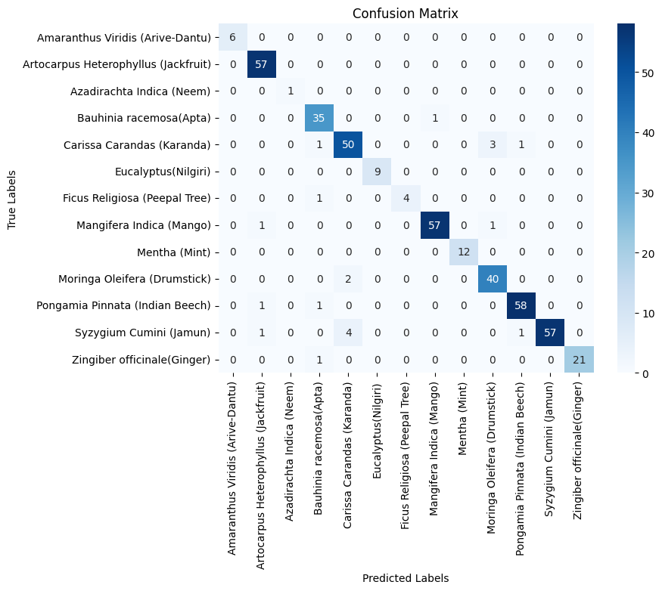
Results-Confusion Matrix for Model 1

Slide 18
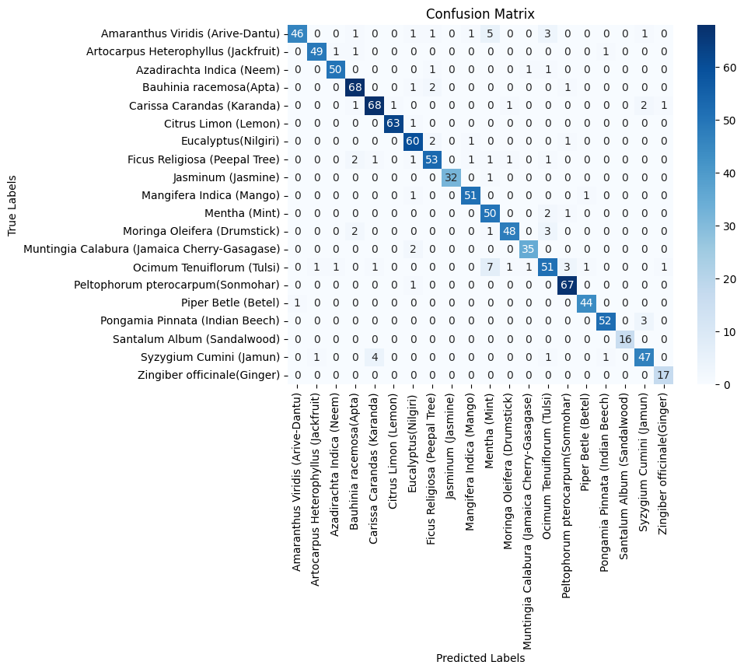
Results-Confusion Matrix for Model 2

Slide 19
Results
Comparison based on F1-score
Models | F1-score
Model 1 | 0.93
Model 2 | 0.95
Based on the comparison of F1-Score for the above models ,the model 2 performed well.
Comparison based on recall,precision,accuracy
Models | Recall | Precision | Accuracy
Model 1 | 91.02 | 90 | 91
Model 2 | 95.05 | 95 | 96

Slide 20
References
[1] P. K. Sekharamantry, Dr. S. Rao, Y. Srinivas, and A. Uriti, "PSR-LeafNet: A Deep Learning Framework for Identifying Medicinal Plant Leaves Using Support Vector Machines," Big Data and Cognitive Computing, vol. 8, no. 12, p. 176, 2024.
[2] M. A. Kiflie, D. P. Sharma, and M. A. Haile, "Deep learning for Ethiopian indigenous medicinal plant species identification and classification," Journal of Ayurveda and Integrative Medicine, vol. 15, no. 6, p. 100987, 2024. [Online]. Available: https://doi.org/10.1016/j.jaim.2024.100987
[3] V. Swu, I. Kharir, and D. Bora, "Identification of Different Plants through Image Processing Using Different Machine Learning Algorithms," Sambodhi, vol. 43, pp. 172-179, 2020.
[4] P. S. Kanda, K. Xia, and O. H. Sanusi, "A deep learning-based recognition technique for plant leaf classification," IEEE Access, vol. 9, pp. 162590-162613, 2021.
[5] M. S. I. Musyaffa, N. Yudistira, M. A. Rahman, A. H. Basori, A. B. F. Mansur, and J. Batoro, "IndoHerb: Indonesia medicinal plants recognition using transfer learning and deep learning," Heliyon, vol. 10, no. 23, 2024.
[6] S. Kavitha, T. Satish Kumar, E. Naresh, V. H. Kalmani, K. D. Bamane, and P. K. Pareek, "Medicinal plant identification in real-time using deep learning model," SN Comput. Sci., vol. 5, no. 73, 2024. doi: 10.1007/s42979-023-02398-5.
[7] A. S. Deshmukh, P. M. Mudhaliar, and S. Thorat, "Ayurvedic plant identification using image processing and artificial intelligence," Int. J. Sci. Res. Comput. Sci. Eng. Inf. Technol., vol. 7, pp. 212-218, 2021.
[8] B. Dey, J. Ferdous, R. Ahmed, and J. Hossain, "Assessing deep convolutional neural network models and their comparative performance for automated medicinal plant identification from leaf images," Heliyon, vol. 10, no. 1, e23655, 2024. [Online]. Available: https://doi.org/10.1016/j.heliyon.2023.e23655
[9] L. Li, Z. M. Li, and Y. Z. Wang, "A method of two-dimensional correlation spectroscopy combined with residual neural network for comparison and differentiation of medicinal plants raw materials superior to traditional machine learning: a case study on Eucommia ulmoides leaves," Plant Methods, vol. 18, no. 1, p. 102, 2022.

Slide 21
Thank You

